Slide 1
Ending the HIV Epidemic Community Forum: Epidemiology of HIV in Riverside County
Epidemiology & Program Evaluation
Riverside University Health System – Public Health

Slide 2
Terms Used in this Report
This report is based on Human Immunodeficiency Virus (HIV) case surveillance in Riverside County, California.
For HIV surveillance,
Prevalence: Refers to living persons with HIV disease who are reported to be living in Riverside County, regardless of time of infection or date of diagnosis.
Incidence: Newly diagnosed cases of HIV in a population during a specific time period.
Rate: Common method used to compare the burden of a disease across populations of different sizes.
PLWH: Persons living with HIV or AIDS (HIV Stage 3)

Slide 3
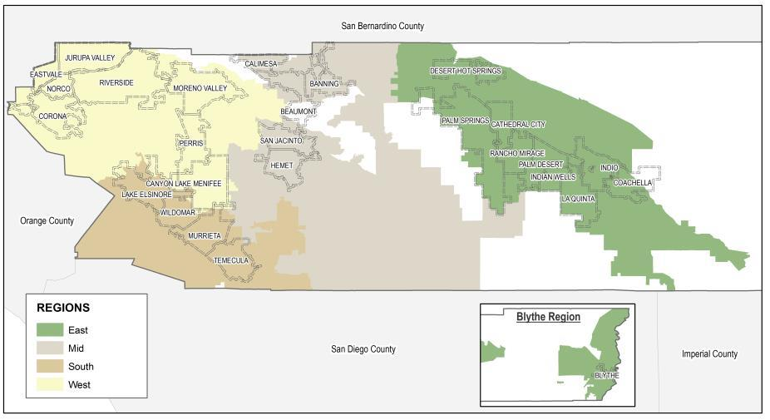
Riverside County, CA

Slide 4
HIV Incidence New HIV cases by year of diagnosis in Riverside County, CA

Slide 5
Count of HIV Diagnoses by Year, Riverside County, CA
Preliminary 2018 numbers

Slide 6
HIV Incidence Rates by Year of Diagnosis and Race/Ethnicity, Riverside County, CA
Preliminary 2018 numbers
Notes:
HIV Reporting was first implemented in California on July 1, 2002, by non-name code.
HIV reporting by name in California began on April 17, 2006.
eHARS and State centralization of HIV/AIDS reporting data began in California on April 2009.

Slide 7
Number of New HIV Cases by Year and Age, Riverside County, CA
Preliminary 2018 numbers
From 2016 – 2018, over forty percent (42.0%) of new HIV cases in Riverside County were in people younger than 30 years old.

Slide 8
HIV Incidence Rate by Year of Diagnosis and County Region, Riverside County, CA
Preliminary 2018 numbers

Slide 9
Reported Risk Factor for HIV Cases Diagnosed from 2014 through 2018, Riverside County, CA
MSM: Men who have sex with men
IDU: Injection Drug Use

Slide 10
Cumulative HIV incidence by zip code, Riverside County, CA 2016 - 2018
838 Total Cumulative Incidence
838 Total Incident Cases

Slide 11
Cumulative HIV incidence of racial minority populations by zip code, Riverside County, CA 2016 - 2018
536 Cumulative Racial Minority Cases
303 Cumulative White Cases

Slide 12
Percent of HIV incidence among people under 30 years of age by zip code, Riverside County, CA 2016 - 2018
352 Cumulative Cases under 30 years of age
324 Cumulative Cases between 30 and 49 years
163 Cumulative Cases 50 years old and older

Slide 13
Notes:
From 2016 through 2018 there were 839 HIV incident cases in Riverside County.
64 percent of incident cases were among racial minority populations.
The median age of HIV Incidence cases was 32 years old.
Median age among white cases: 42
Median age among racial minority cases: 30
42 percent of incident cases were under 30 years old.

Slide 14
Aaron T. Gardner, MA, MPH, CPH Research Specialist II
Epidemiology & Program Evaluation
(951) 358-5557
agardner@ruhealth.org
www.rivcohealthdata.org
www.shaperivco.org
Contributing RUHS-PH Staff: Tad A. Berman, Erin Curlee, Amy Hyong, Dianne Leibrandt,
Lea Morgan, Sheena Patel

